Slide 1
The Authentication Equation Visualizing the convergence of security and usability of text-based passwords
Cathryn Ploehn, Kristen Greene
United States National Institute of Standards and Technology

Slide 2
a universal struggle of the modern human

Slide 3
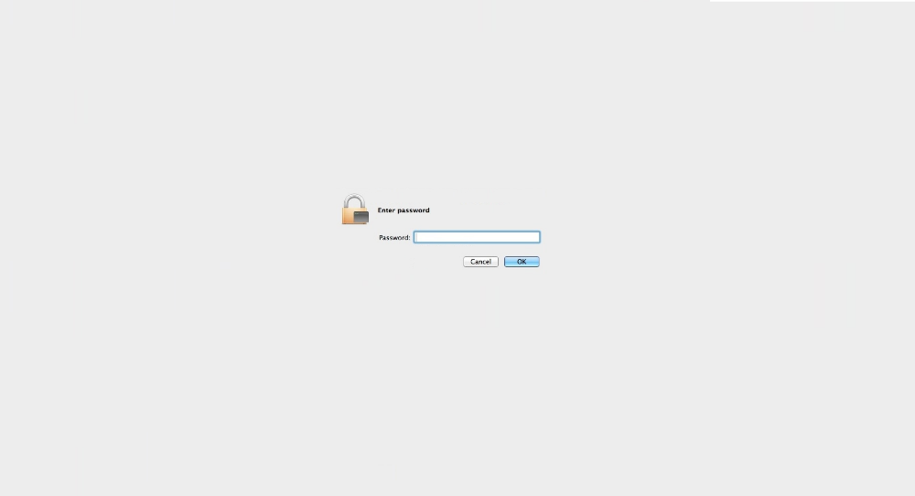
Notes:
Text based authentication

Slide 4
text-based passwords
Lacking in usability
Winning in longevity

Slide 5
text-based passwords
Super secure
super secure?
Managed by unusable (but secure) requirements

Slide 6
text-based passwords
Managed by unusable (but secure) requirements,
which cause mental strain

Slide 7
0Vi:cxsyn03'An

Slide 8
0Vi:cxsyn03'An

Slide 9
Do I exist?
security
usability

Slide 10
Can we optimize password requirements for usability?
(while maintaining the security)

Slide 11
Identify which aspects of secure passwords lead to usability failures

Slide 12
Number of symbols
0Vi:cxsyn03'An
Number of digits
length

Slide 13
Explore the interaction between security and usability components of passwords

Slide 14
":MD}X,3r+v",1,3,0,1,0,0,5,65.54588851677637,"MDXrv3:},+",51.92475240350173,13.621136113274641,20.781068685625232,0,3,2,1,0,0,6,23,17,23,17,16,16,10,5,1,4
{Pfu_7P5>i,1,1,2,0,1,-1,4,65.54588851677637,PPfui75{_>,50.92475240350173,14.621136113274641,22.306717391636827,0,1,3,1,0,-1,4,22,14,22,14,15,15,10,5,2,3
"^,:Ll4~2R^",1,5,1,0,0,0,7,65.54588851677637,"LRl42^,:~^",52.661717997667935,12.884170519108435,19.656718080510498,0,5,2,1,0,0,8,22,16,19,15,16,16,10,3,2,5
3wA5~wfyRe,0,0,2,2,1,-2,3,65.54588851677637,ARwwfye35~,52.661717997667935,12.884170519108435,19.656718080510498,0,0,4,1,0,-1,4,17,14,17,14,13,13,10,7,2,1
"r};1:=Z,Nb",0,7,0,0,0,0,7,65.54588851677637,"ZNrb1};:=,",52.661717997667935,12.884170519108435,19.656718080510498,0,5,2,1,0,0,8,19,17,19,17,14,14,10,4,1,5
st<gOfZ@&8,0,3,1,1,0,-1,4,65.54588851677637,OZstgf8<@&,51.92475240350173,13.621136113274641,20.781068685625232,0,1,3,1,0,-1,4,16,15,16,15,15,15,10,6,1,3
dJ}5GRA8pj,0,0,2,2,1,-1,4,65.54588851677637,JGRAdpj58},51.92475240350173,13.621136113274641,20.781068685625232,0,0,4,1,0,-1,4,20,16,20,16,15,15,10,7,2,1
",)1i*ZNq;U",1,3,1,1,0,0,6,65.54588851677637,"ZNUiq1,)*;",51.92475240350173,13.621136113274641,20.781068685625232,0,3,2,1,0,-1,5,20,16,19,14,15,15,10,5,1,4
i&#8Zw$NS$,0,3,1,1,0,0,5,65.54588851677637,ZNSiw8&#$$,51.92475240350173,13.621136113274641,20.781068685625232,0,3,2,1,0,-1,5,20,16,20,16,17,17,10,5,1,4
h|v+wzDA3N,0,1,2,1,1,-1,4,65.54588851677637,DANhvwz3|+,51.92475240350173,13.621136113274641,20.781068685625232,0,0,3,1,0,-1,3,21,15,21,15,15,15,10,7,1,2
!0vG.bvc@h,1,1,2,1,0,0,5,65.54588851677637,Gvbvch0!.@,53.2466804983891,12.29920801838728,18.76427079821996,0,1,3,0,0,0,4,17,12,17,12,13,13,10,6,1,3
qw|43#UHbh,0,1,1,1,0,-1,2,65.54588851677637,UHqwbh43|#,51.33978990278057,14.206098613995799,21.673515967915773,0,0,3,1,0,-1,3,17,14,17,14,14,14,10,6,2,2
tw|850|_iB,0,3,1,1,0,-1,4,65.54588851677637,Btwi850||_,51.50971490422289,14.036173612553485,21.41427010934629,0,1,3,0,0,-1,3,16,13,16,13,14,14,10,4,3,3
4]I]i~L4Kn,0,3,1,0,1,0,5,65.54588851677637,ILKin44]]~,50.92475240350173,14.621136113274641,22.306717391636827,0,1,3,1,0,-1,4,24,15,24,15,14,14,10,5,2,3
!l:z3LM%8M,1,1,1,1,1,0,5,65.54588851677637,LMMlz38!:%,50.92475240350173,14.621136113274641,22.306717391636827,0,1,3,1,0,0,5,23,15,23,15,16,16,10,5,2,3
wEqC)8gdwl,0,0,2,1,0,-1,2,65.54588851677637,ECwqgdwl8),54.2466804983891,11.29920801838728,17.238622092208367,0,0,4,1,0,-1,4,14,13,14,13,13,13,10,8,1,1
?<o2$YE}jQ,1,3,0,2,0,-1,5,65.54588851677637,YEQoj2?<$},51.92475240350173,13.621136113274641,20.781068685625232,0,3,2,1,0,-1,5,21,17,21,17,17,17,10,5,1,4
m{&n3S5G2s,0,1,2,0,1,0,4,65.54588851677637,SGmns352{&,50.92475240350173,14.621136113274641,22.306717391636827,0,0,3,1,0,0,4,22,15,22,15,14,14,10,5,3,2
[35<TuIqvq,1,0,2,1,0,-1,3,65.54588851677637,TIuqvq35[<,51.33978990278057,14.206098613995799,21.673515967915773,0,0,3,1,0,-1,3,17,14,17,14,13,13,10,6,2,2
"yyY,wbDZ0@",0,0,3,2,0,-1,4,65.54588851677637,"YDZyywb0,@",51.92475240350173,13.621136113274641,20.781068685625232,0,0,3,1,0,-1,3,16,14,16,14,14,14,10,7,1,2
"1,(*sT*zWx",0,5,0,2,0,0,7,65.54588851677637,"TWszx1,(**",51.92475240350173,13.621136113274641,20.781068685625232,0,3,2,1,0,0,6,18,14,16,13,15,15,10,5,1,4
!4UH>t6L<K,1,1,2,1,1,-1,5,65.54588851677637,UHLKt46!><,51.92475240350173,13.621136113274641,20.781068685625232,0,1,3,1,0,-1,4,24,16,24,16,17,17,10,5,2,3
dLZx{s$1i:,0,1,1,1,0,0,3,65.54588851677637,LZdxsi1{$:,51.92475240350173,13.621136113274641,20.781068685625232,0,1,3,1,0,-1,4,18,15,18,15,15,15,10,6,1,3
;5NemelGX8,1,0,4,1,1,-1,6,65.54588851677637,NGXemel58;,51.92475240350173,13.621136113274641,20.781068685625232,0,0,4,1,0,-1,4,16,14,16,14,13,13,10,7,2,1
"i7#op,N2c6",0,1,1,0,1,-1,2,65.54588851677637,"Niopc726#,",51.92475240350173,13.621136113274641,20.781068685625232,0,0,3,0,0,-1,2,19,14,19,14,12,12,10,5,3,2
t-pg8ceMUs,0,0,3,1,1,-1,4,65.54588851677637,MUtpgces8-,54.2466804983891,11.29920801838728,17.238622092208367,0,0,4,1,0,-1,4,16,13,16,13,12,12,10,8,1,1
j;W7<=p*lq,0,5,0,0,0,0,5,65.54588851677637,Wjplq7;<=*,52.92475240350173,12.621136113274641,19.25541997961364,0,3,2,0,0,0,5,19,13,18,14,13,13,10,5,1,4
:r6Sa/t*|&,1,5,1,0,1,-1,7,65.54588851677637,Srat6:/*|&,53.2466804983891,12.29920801838728,18.76427079821996,0,5,2,0,0,-1,6,20,14,20,14,15,15,10,4,1,5
1$Z?=LK(Eo,0,5,0,1,0,0,6,65.54588851677637,ZLKEo1$?=(,52.92475240350173,12.621136113274641,19.25541997961364,0,3,2,1,0,-1,5,21,17,21,17,17,17,10,5,1,4
wu*QjE{u{3,0,3,1,1,0,-2,3,65.54588851677637,QEwuju3*{{,51.92475240350173,13.621136113274641,20.781068685625232,0,1,3,1,0,-1,4,21,14,20,14,15,15,10,6,1,3
0&BvcTBJua,0,0,3,1,0,-1,3,65.54588851677637,BTBJvcua0&,52.92475240350173,12.621136113274641,19.25541997961364,0,0,4,1,0,0,5,16,15,16,15,15,15,10,8,1,1
%@5B{0bNHL,1,1,2,1,0,0,5,65.54588851677637,BNHLb50%@{,51.92475240350173,13.621136113274641,20.781068685625232,0,1,3,1,0,0,5,22,18,22,18,17,17,10,5,2,3
oPML~G}O8g,0,1,1,1,1,-1,3,65.54588851677637,PMLGOog8~},52.661717997667935,12.884170519108435,19.656718080510498,0,0,3,1,0,-1,3,23,17,23,17,17,17,10,7,1,2
"7o{,%~hM6D",0,5,1,1,1,-1,7,65.54588851677637,"MDoh76{,%~",51.33978990278057,14.206098613995799,21.673515967915773,0,3,2,1,0,-1,5,21,16,21,16,15,15,10,4,2,4
^d)6JgD:N8,1,1,1,1,0,0,4,65.54588851677637,JDNdg68^):,50.92475240350173,14.621136113274641,22.306717391636827,0,1,3,1,0,0,5,21,16,20,14,16,16,10,5,2,3
b5SAY8V7n$,0,0,4,1,1,-1,5,65.54588851677637,SAYVbn587$,51.92475240350173,13.621136113274641,20.781068685625232,0,0,4,1,0,-1,4,21,15,21,15,15,15,10,6,3,1
j;LqL8GHN8,0,0,3,1,1,0,5,65.54588851677637,LLGHNjq88;,52.661717997667935,12.884170519108435,19.656718080510498,0,0,4,1,0,0,5,20,16,20,16,15,15,10,7,2,1
&G};a+5.}Z,1,7,0,0,0,0,8,65.54588851677637,GZa5&};+.},54.2466804983891,11.29920801838728,17.238622092208367,0,7,1,1,0,-1,8,23,18,23,18,16,16,10,3,1,6
^S9ha|[c&a,1,3,1,0,1,-1,5,65.54588851677637,Shaca9^|[&,52.92475240350173,12.621136113274641,19.25541997961364,0,3,2,0,0,-1,4,21,14,20,14,14,14,10,5,1,4
8Y*sAm>H[l,0,3,1,1,0,-1,4,65.54588851677637,YAHsml8*>[,51.50971490422289,14.036173612553485,21.41427010934629,0,1,3,1,0,-1,4,24,15,23,15,15,15,10,6,1,3
gN2b[7K(Al,0,1,1,1,1,-1,3,65.54588851677637,NKAgbl27[(,50.92475240350173,14.621136113274641,22.306717391636827,0,0,3,1,0,-1,3,21,16,21,16,14,14,10,6,2,2
}GdB.J/2pJ,1,1,2,2,0,0,6,65.54588851677637,GBJJdp2}./,51.92475240350173,13.621136113274641,20.781068685625232,0,1,3,1,0,0,5,21,17,21,17,15,15,10,6,1,3

Slide 16
visualization tool to explore usability and security password metrics

Slide 17
Goals of the tool
support password usability research activities
integrate various measurements of passwords
leverage web technology

Slide 18
Goals of the tool
flexibly display data
enable the exploration of where password security and usability collide
share with research community as an open source tool

Slide 19
Tool composition
Password metric computation
Python3 code, run from terminal
Password metric visualization
Browser, D3.js

Slide 20
1
usability
and security metrics

Slide 21
task: automate computation of password metrics

Slide 22
metrics

Slide 23
Entropy
Uncertainty in a random variable, commonly used to measure theoretical password strength
Has limitations
**Line used as an example – does not reflect real data

Slide 24
Linguistic and phonological difficulty
Similarity of password to natural language.

Slide 25
How pronounceable is a password?

Slide 26
Number of keystrokes
Number of keystrokes to enter a password in
desktop, android, and iOS devices.

Slide 27
Password permutation
Rearrange passwords by character type to decrease keystrokes needed to enter on mobile devices

Slide 28
Password permutation
Original password
9#@z$tgH
Permuted password
Hztg9#@$

Slide 29
Outcome: code to produce metrics for a list of passwords

Slide 30
data
Original password
9#@z$tgH
Permuted password
Hztg9#@$

Slide 31
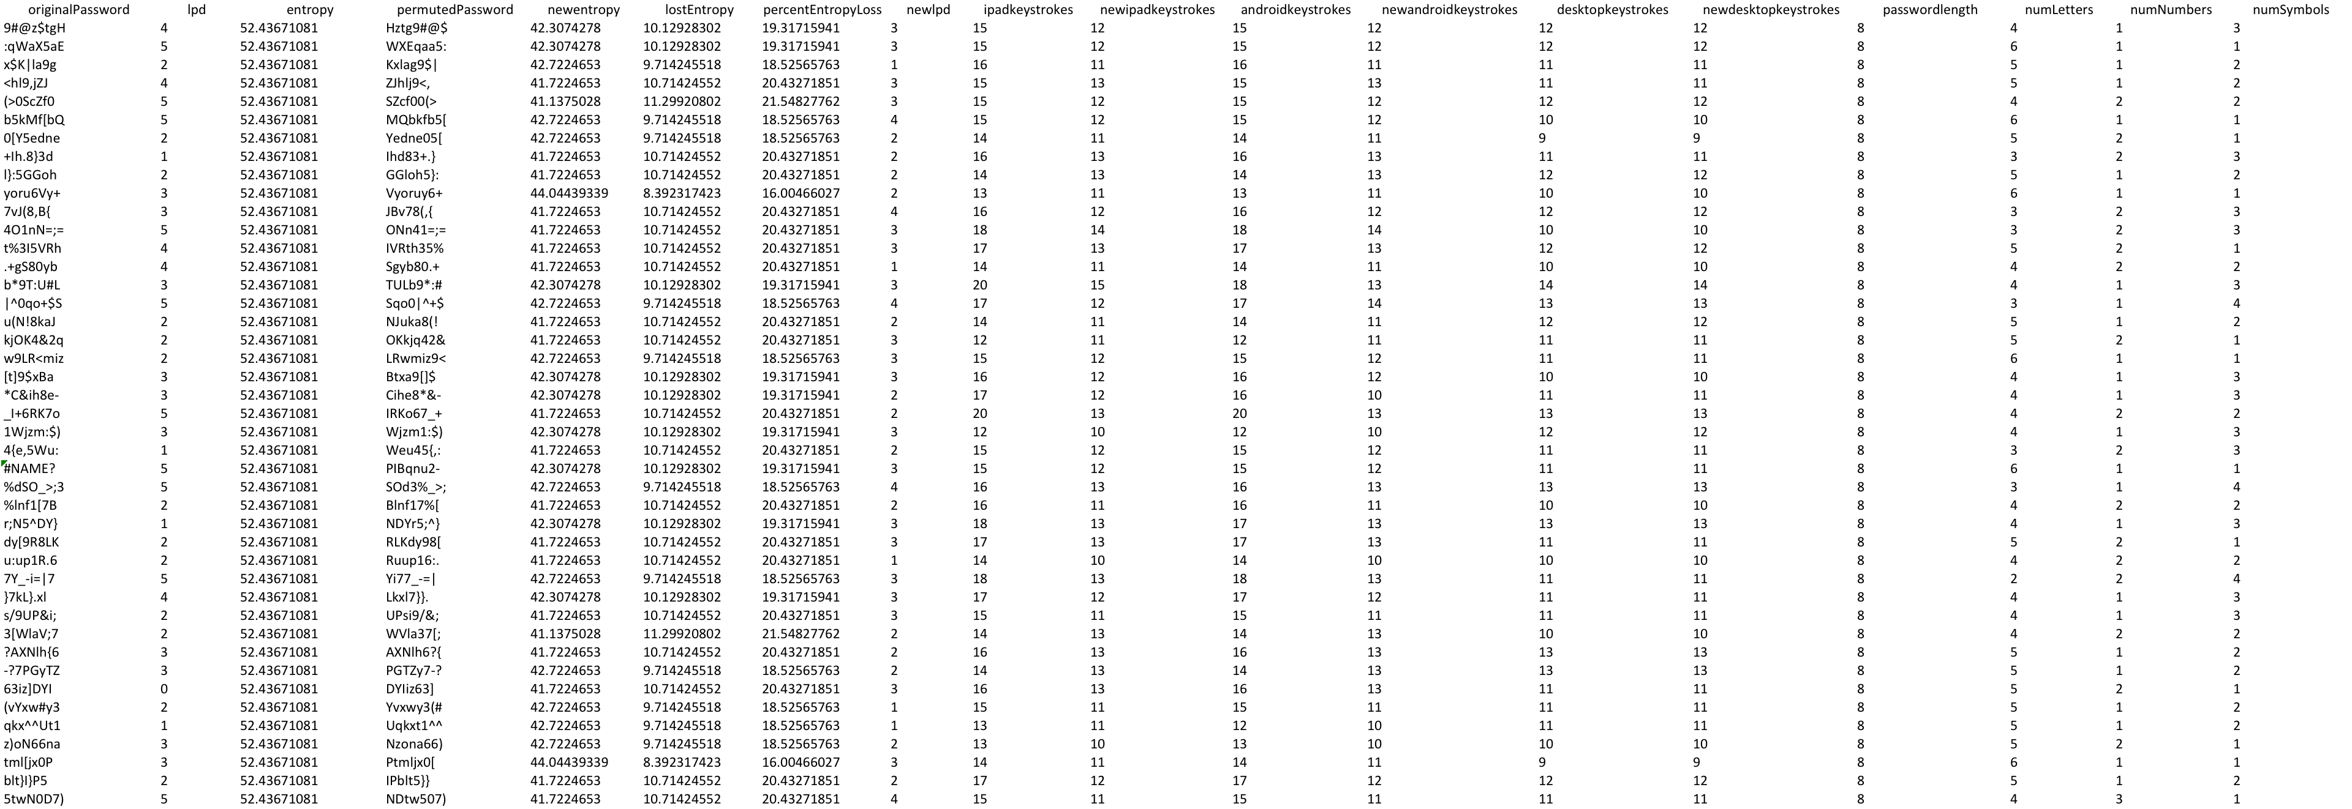
data

Slide 32
How can we view and interact with the data?

Slide 33
2
Building a password
visualization tool

Slide 35
Design goals
Scalability
Tiers of granularity
Side by side comparison
Interactivity

Slide 36
visualization in the browser
Available, flexible, interactive

Slide 37
visualization in the browser
HTML, CSS, JavaScript

Slide 38
D3.js

Slide 39
Heatmap
higher value
lower value

Slide 40
Heatmap
Original password metrics
Permuted password metrics

Slide 41
Heatmap
Original password metrics
Permuted password metrics
New desktop keystrokes
New Android keystrokes
Desktop keystrokes
Android keystrokes
New iOS keystrokes
iOS keystrokes
New entropy
entropy
New LPD
LPD

Slide 42
Scalability
Works for ten, one hundred, one thousand passwords

Slide 43
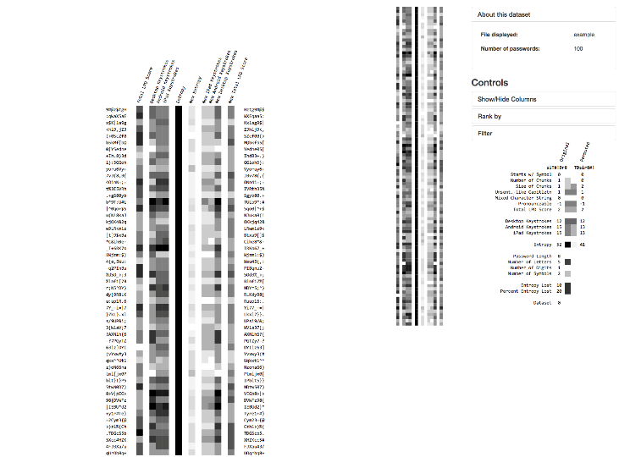
Tiers of granularity
Overview first, then details on demand

Slide 44
Tiers of granularity
Overview first, then details on demand

Slide 45
Tiers of granularity
Overview first, then details on demand

Slide 46
Tiers of granularity
Overview first, then details on demand

Slide 47
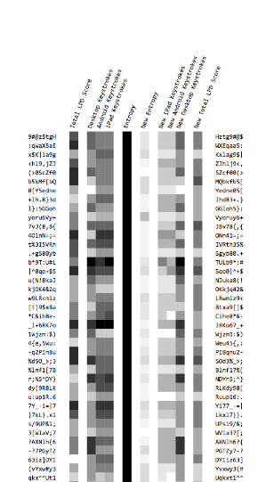
Side by side comparison
Compare passwords with their
permuted counterparts

Slide 48
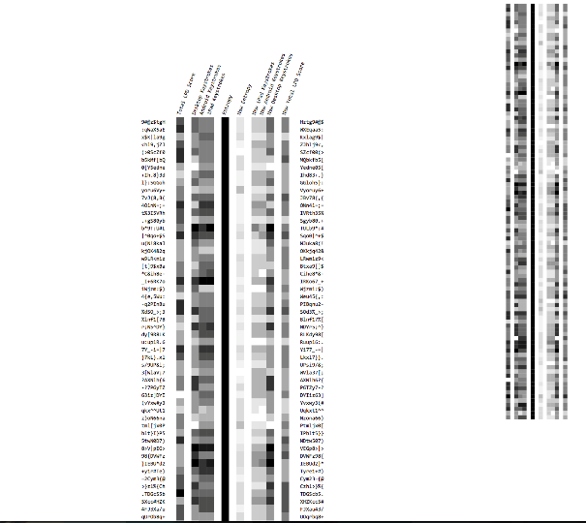
Interactivity
Filter, sort, etc.

Slide 49
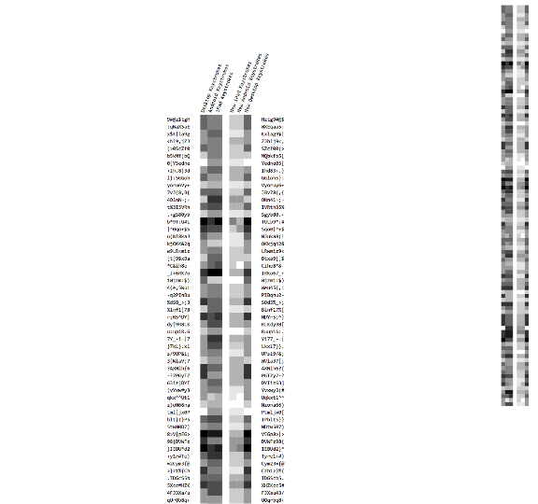
Interactivity
Hide columns

Slide 50
Interactivity
Hide columns

Slide 51
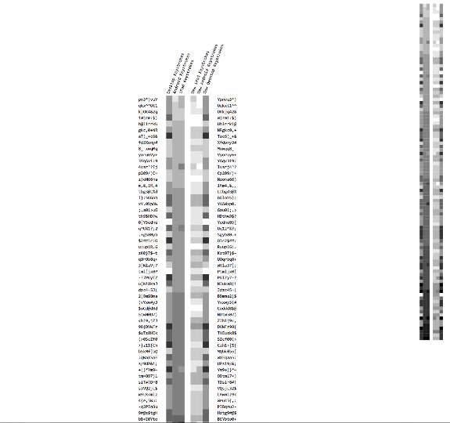
Interactivity
Sort rows

Slide 52
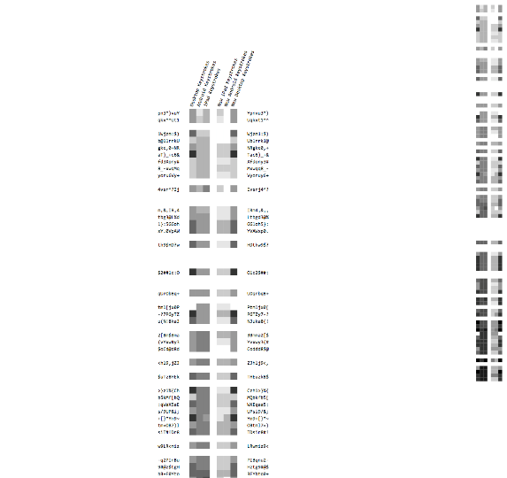
Interactivity
Filter rows

Slide 53
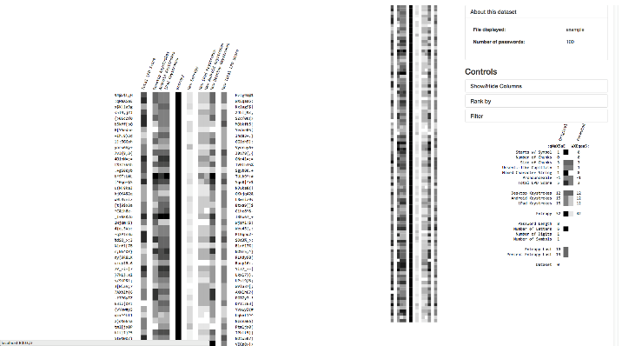

Slide 54
Limitations
Number of passwords viewable still low
Relationships hard to view
Can’t compare multiple datasets

Slide 55
Limitations
Code organization
Usability
Requires hard coding
GUI could do more

Slide 56
Tool improvements
More visualization paradigms
Compare multiple datasets
GUI improvements
Restructure code

Slide 57
Parallel coordinates
Common way of analyzing multivariate data

Slide 58
Parallel coordinates
Increase the number of passwords capable of being rendered

Slide 59
Parallel coordinates
Makes relationships between variables more apparent

Slide 60
< canvas >
Render larger datasets by queuing data to be rendered

Slide 62
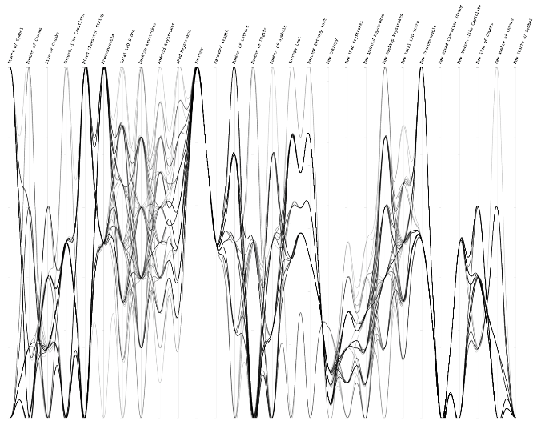
Scalability
Works for 1000+ passwords

Slide 63
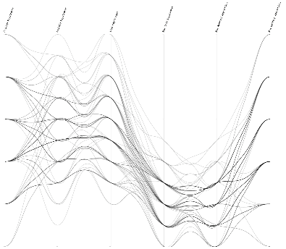
Side by side comparison
Compare passwords with their permuted counterparts

Slide 64
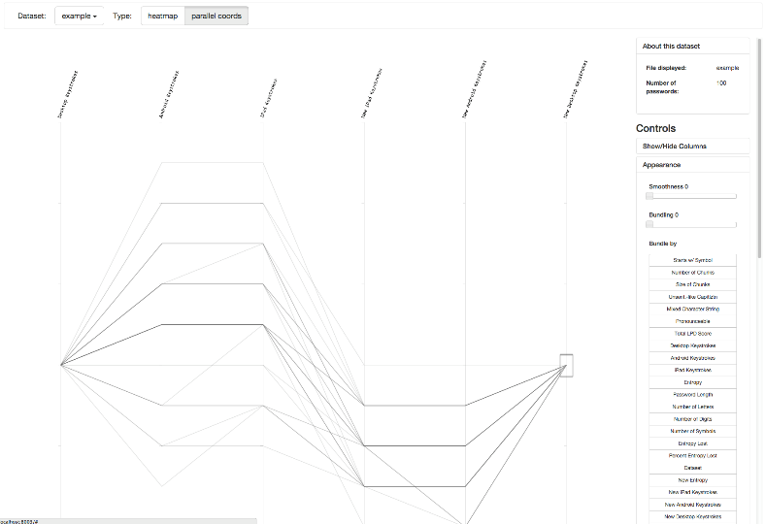
Interactivity
Filter, sort, etc.

Slide 65
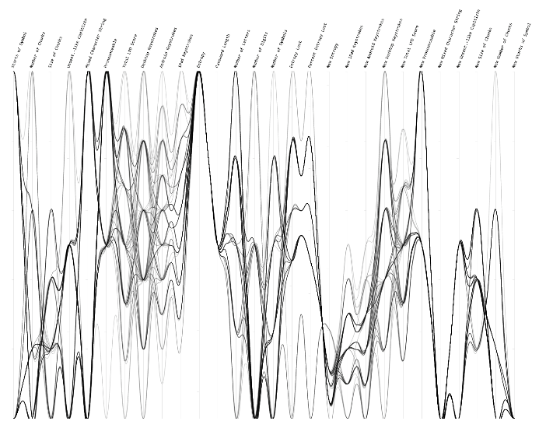
Hide columns

Slide 66
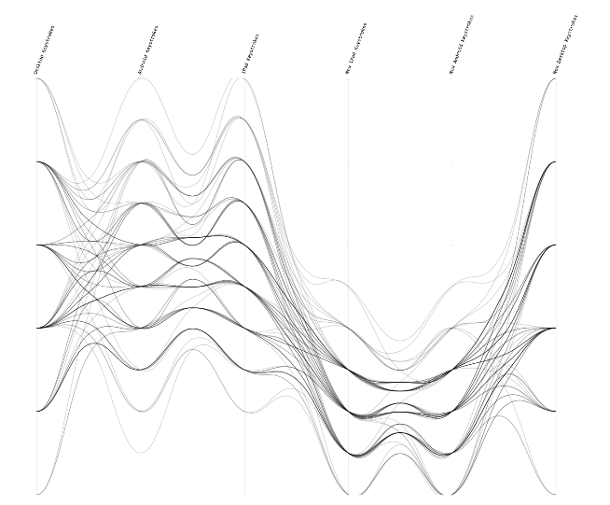
Hide columns

Slide 67
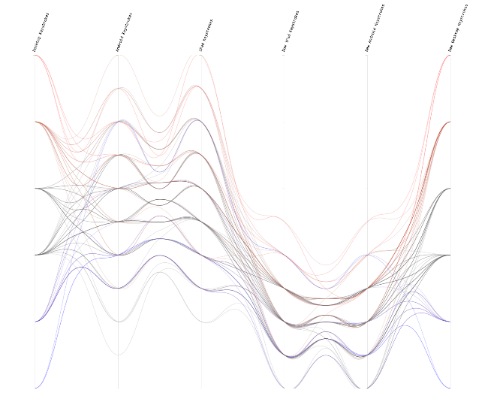
Change line coloring

Slide 68
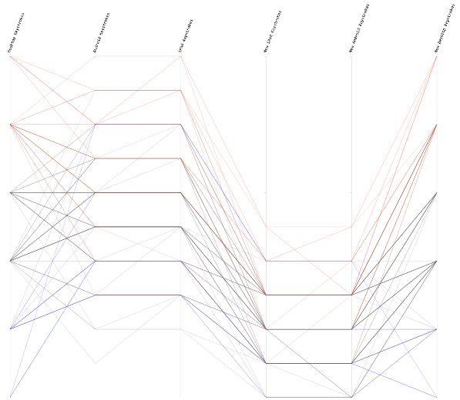
Change line
bundling & smoothness

Slide 69
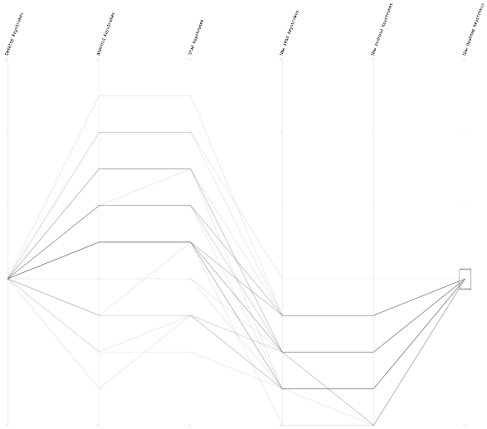
Brushing

Slide 70
Compare datasets

Slide 71
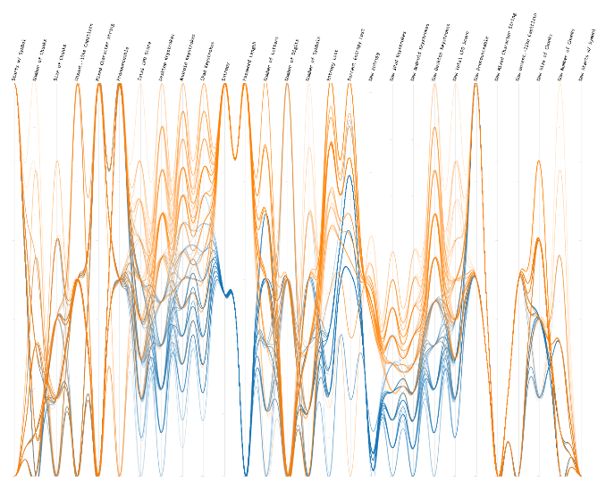

Slide 72
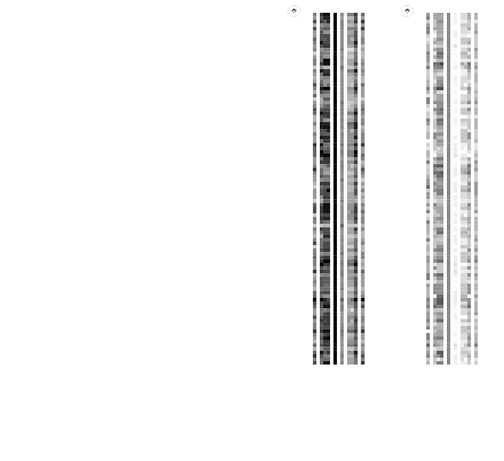

Slide 73
GUI improvements

Slide 74
GUI improvements

Slide 75
Code restructuring
Modular design, reuse for other multivariate data

Slide 76
3
Walkthrough

Slide 77
4
Lessons
learned

Slide 78
Understand and communicate the encoding scheme of visualization

Slide 81
Understand constraints of specialized visualization tools

Slide 82
Future work
Compare the LPD score with usability data
Expansion of security metrics / accurate description of password strength
Expand into a generic multivariate data analysis tool
Client side calculation of password values

Slide 83
Thank you
Reach out
cathryn.ploehn@nist.gov
@cathrynploehn
The tool
github.com/usnistgov/DataVis

Slide 84
Questions?
Reach out
cathryn.ploehn@nist.gov
@cathrynploehn
The tool
github.com/usnistgov/DataVis

